Slide 1
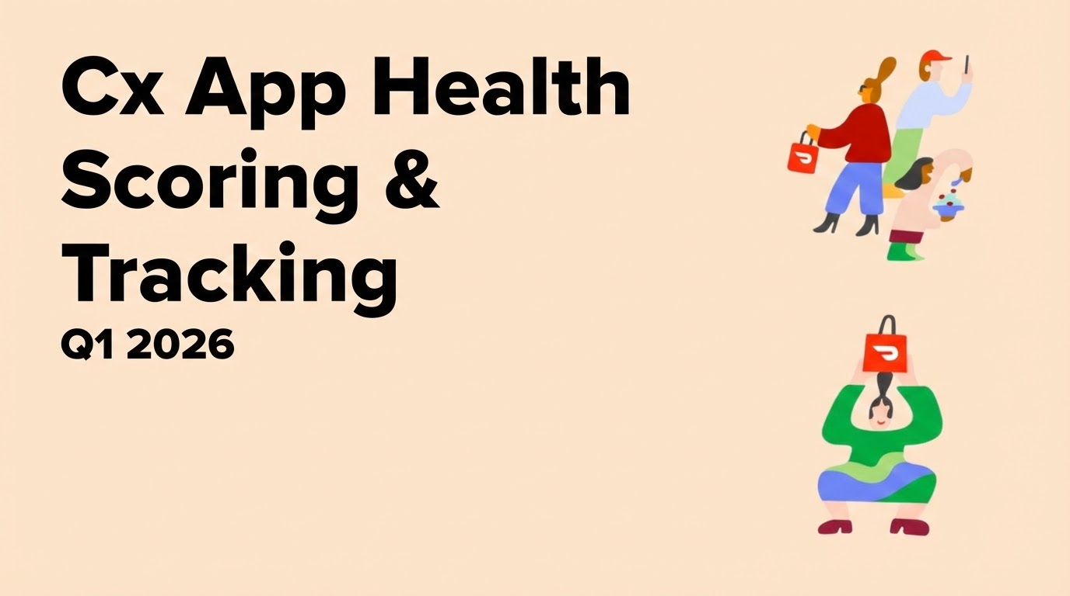

Slide 2
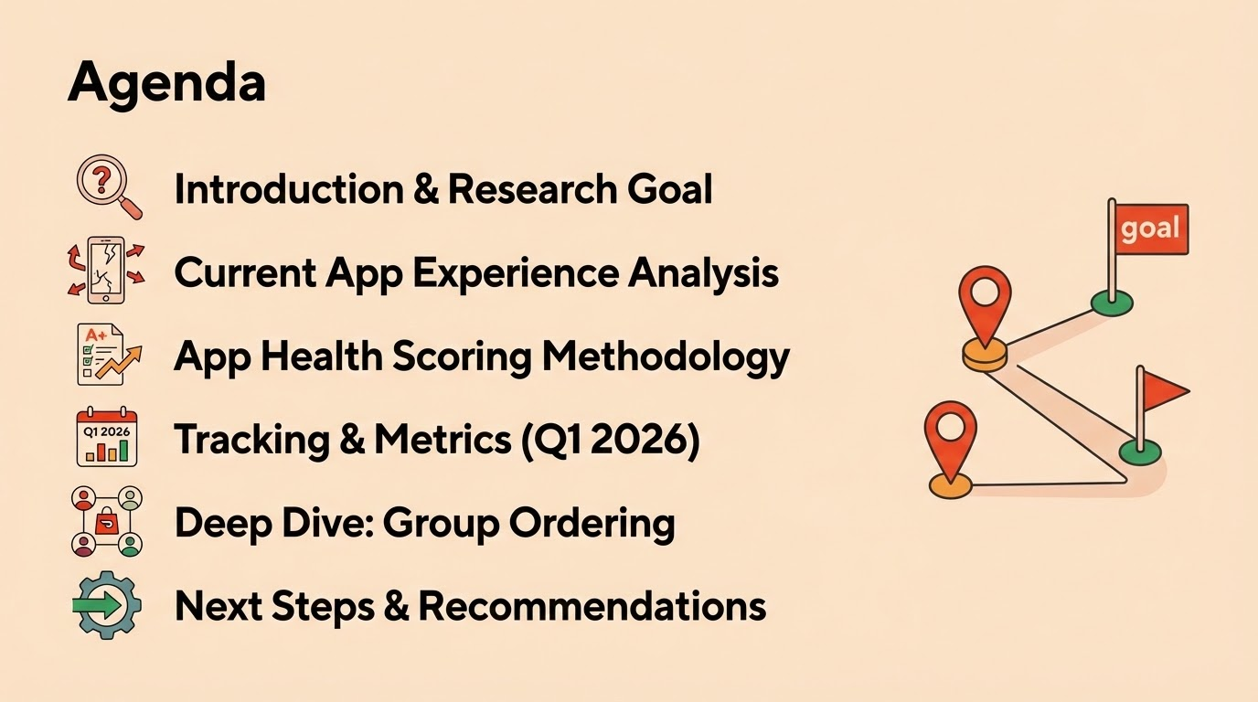

Slide 3
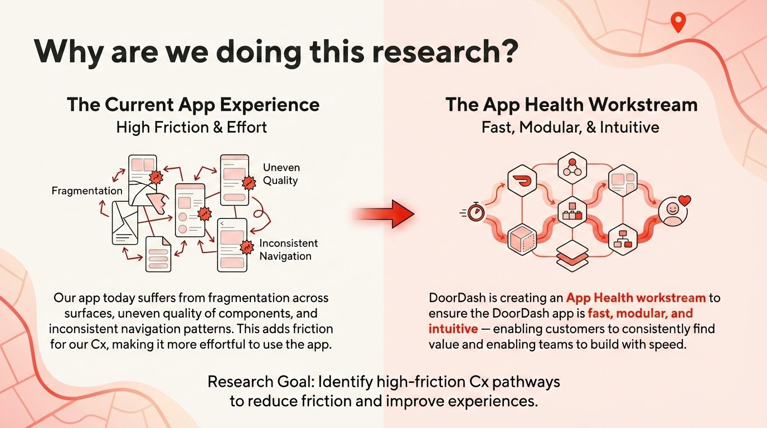

Slide 4
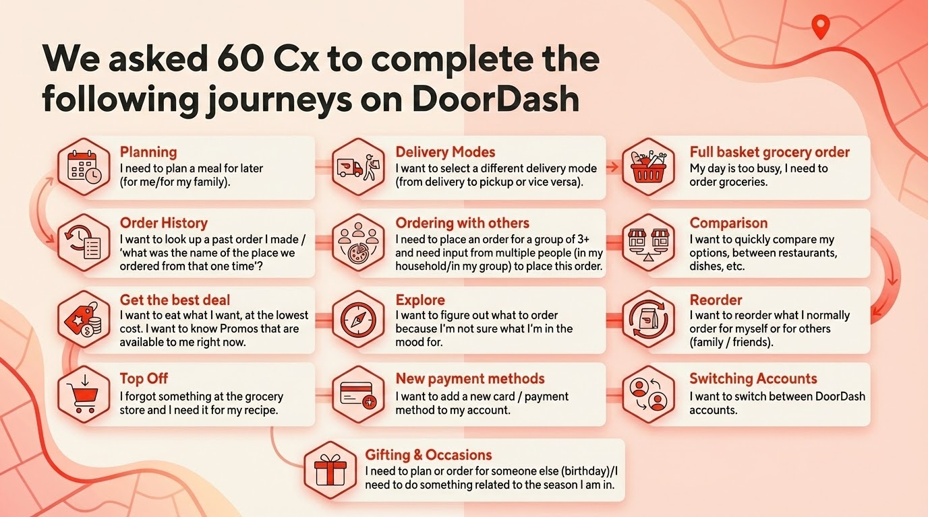

Slide 5
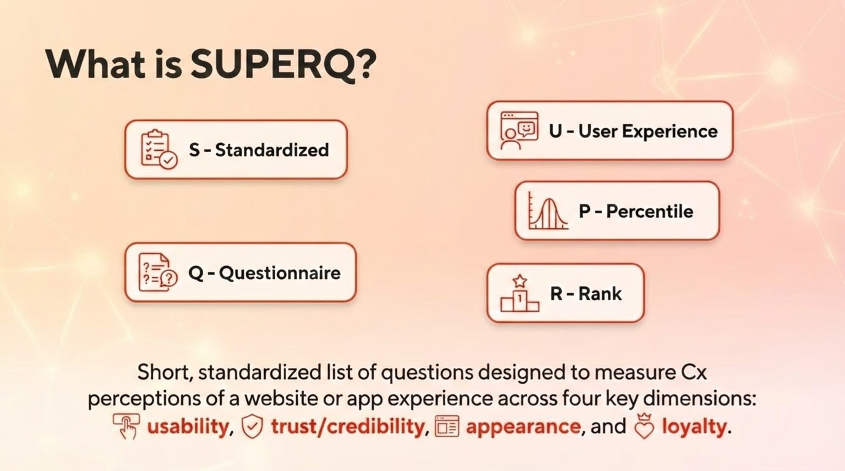

Slide 6
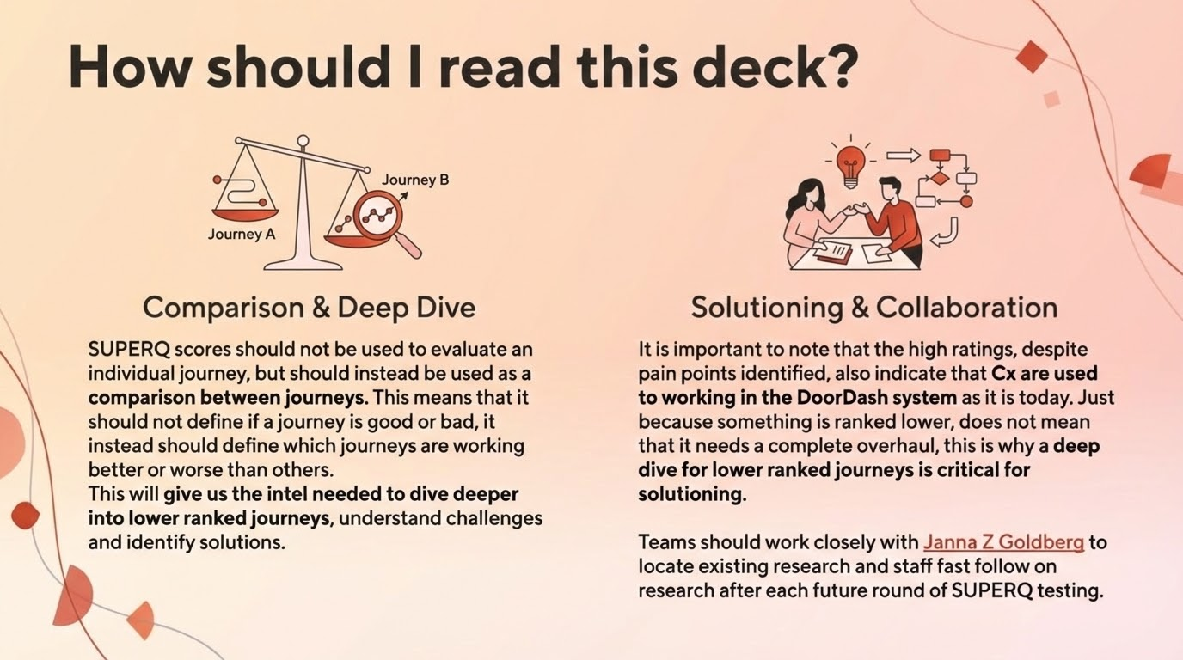

Slide 7
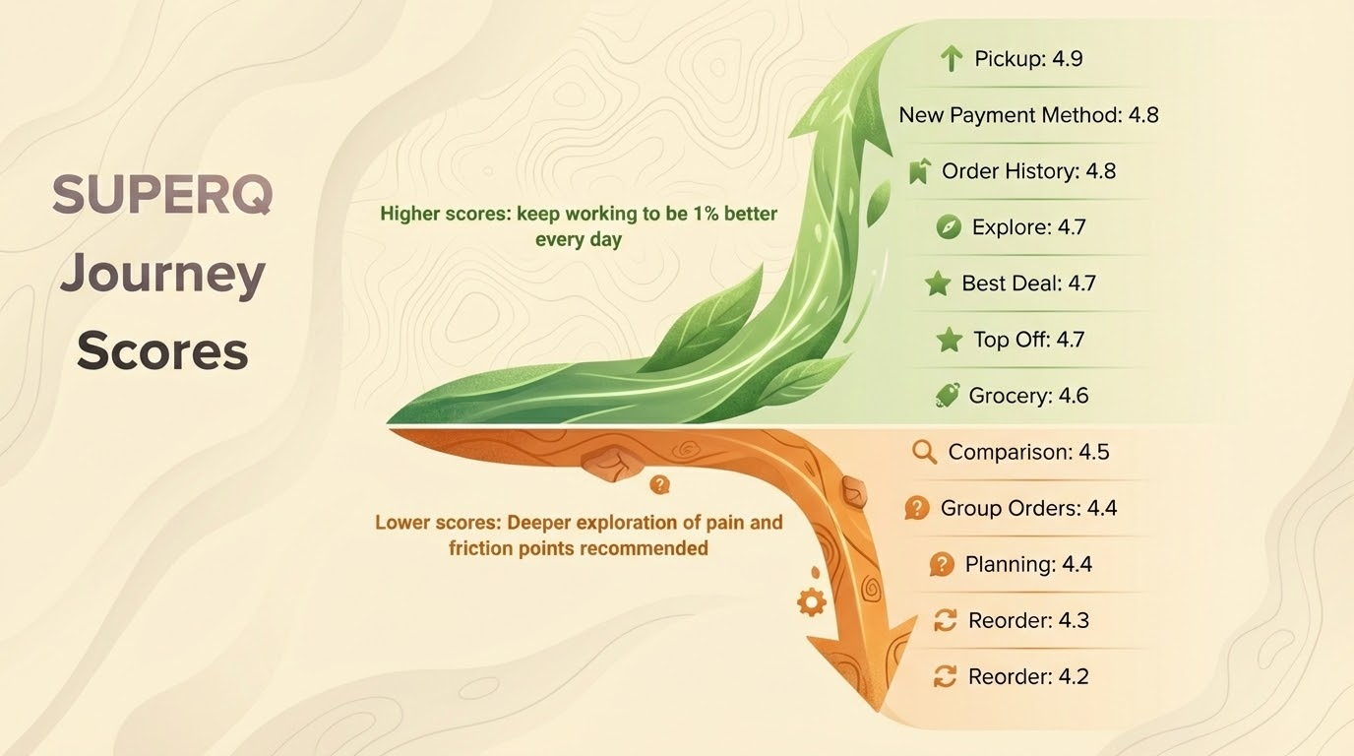

Slide 8
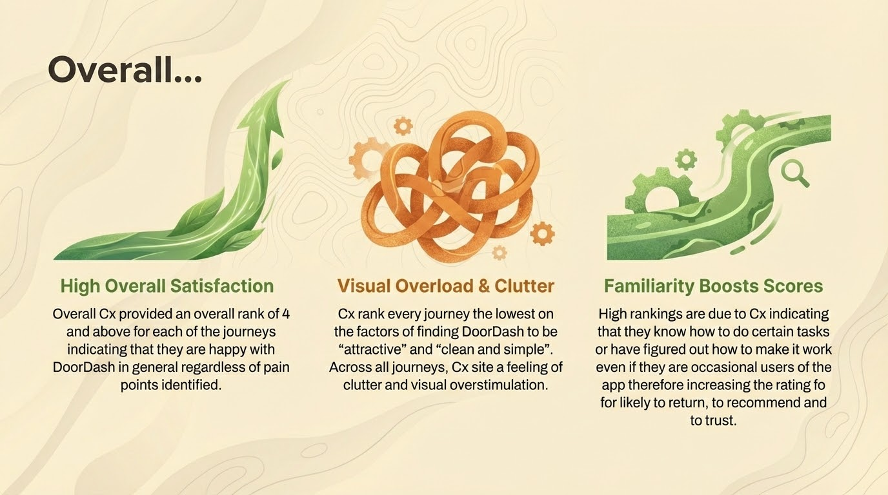

Slide 9


Slide 10
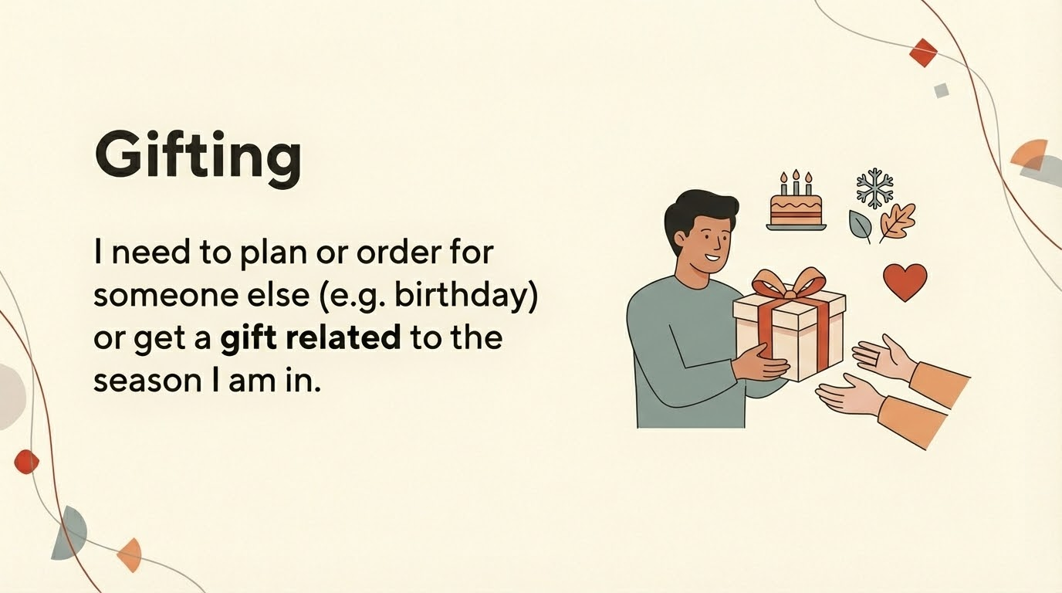

Slide 11
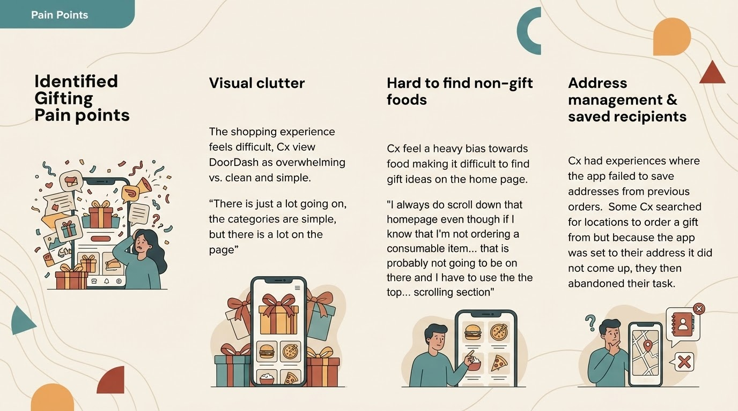

Slide 12


Slide 13
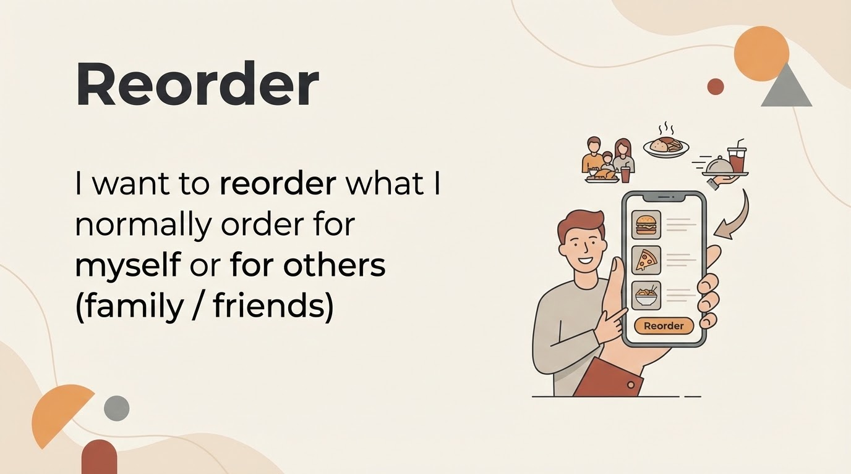

Slide 14
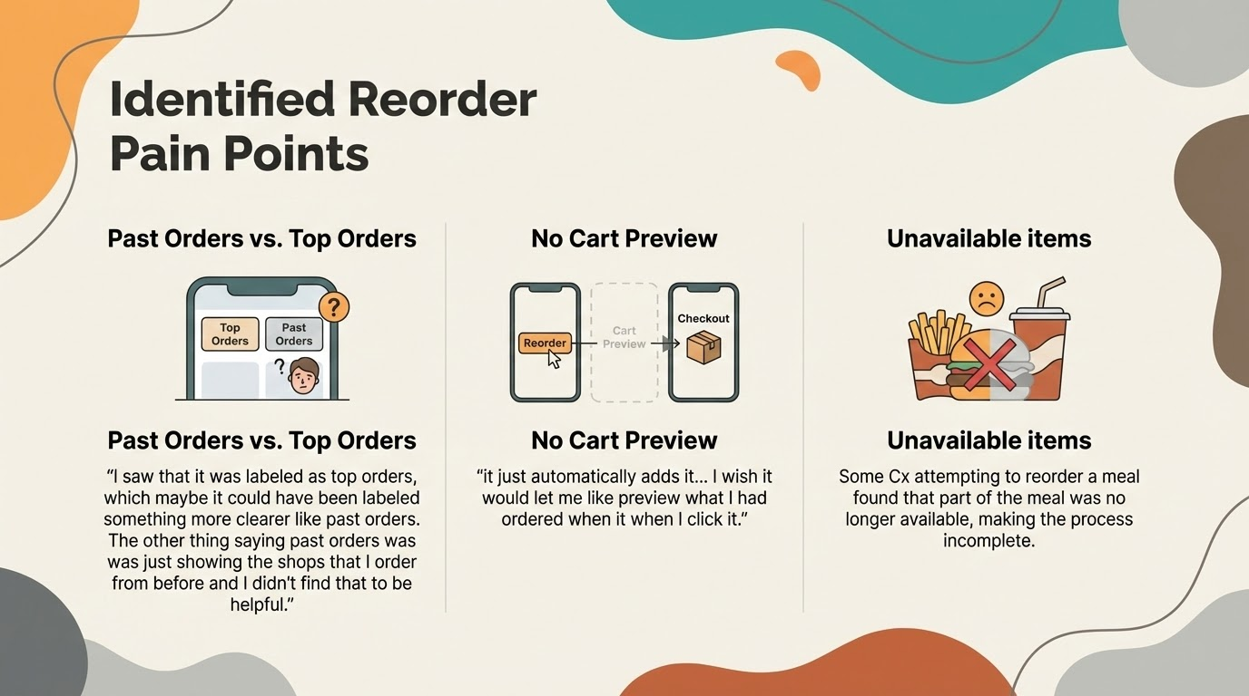

Slide 15
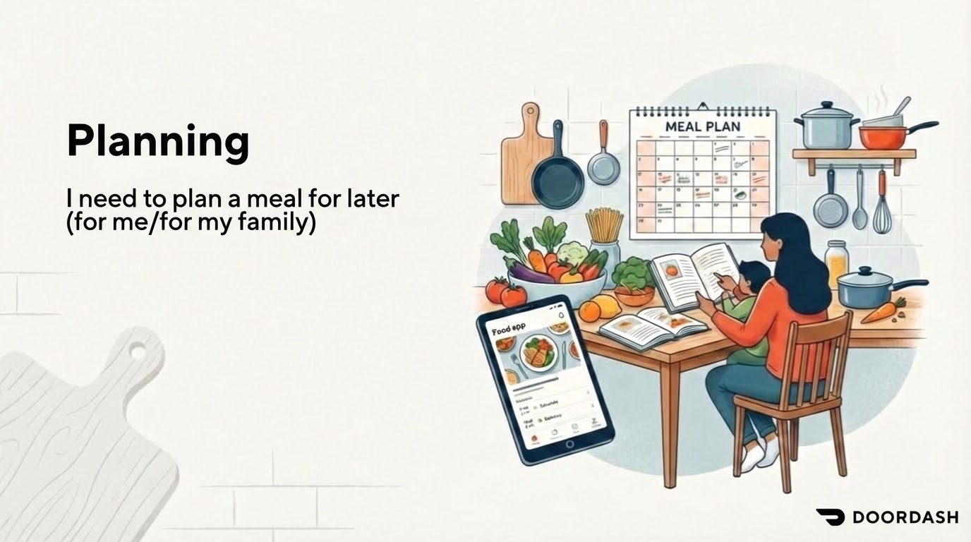

Slide 16
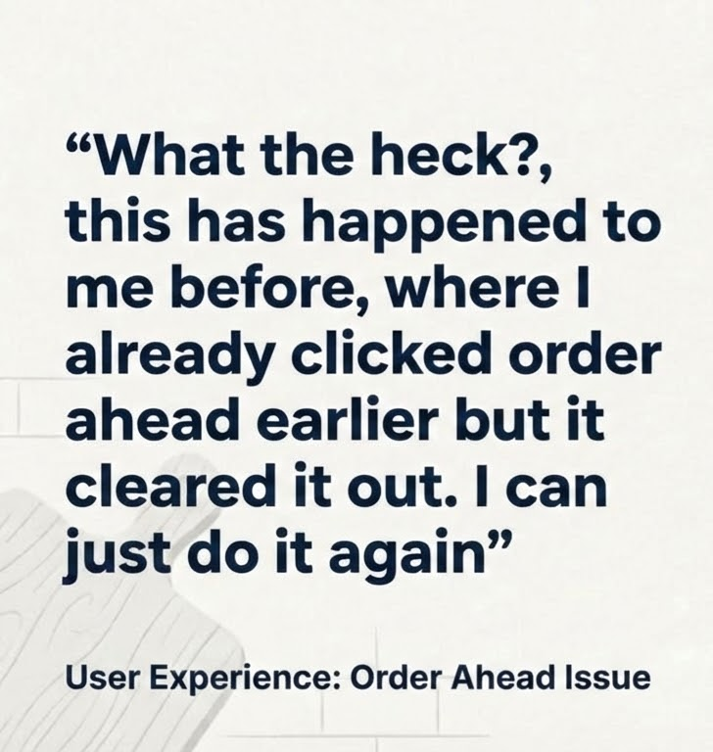
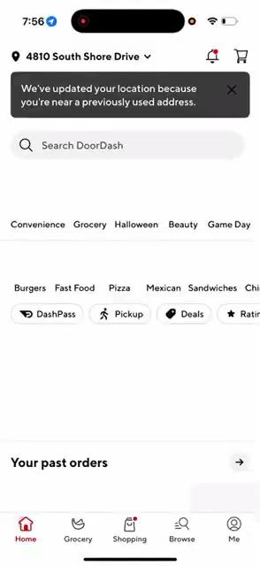
Notes:
During the ordering flow, Cx’s needs depend on how far down they get in cart building!
Before adding anything to cart → 1, 2, 3
We have historically leaned on using visual, personalized experiences to highlight why a Rx is great; we rely on social proof signals like ratings (store or item level) and relevant deals to ‘convince’ a Cx to order.

Slide 17
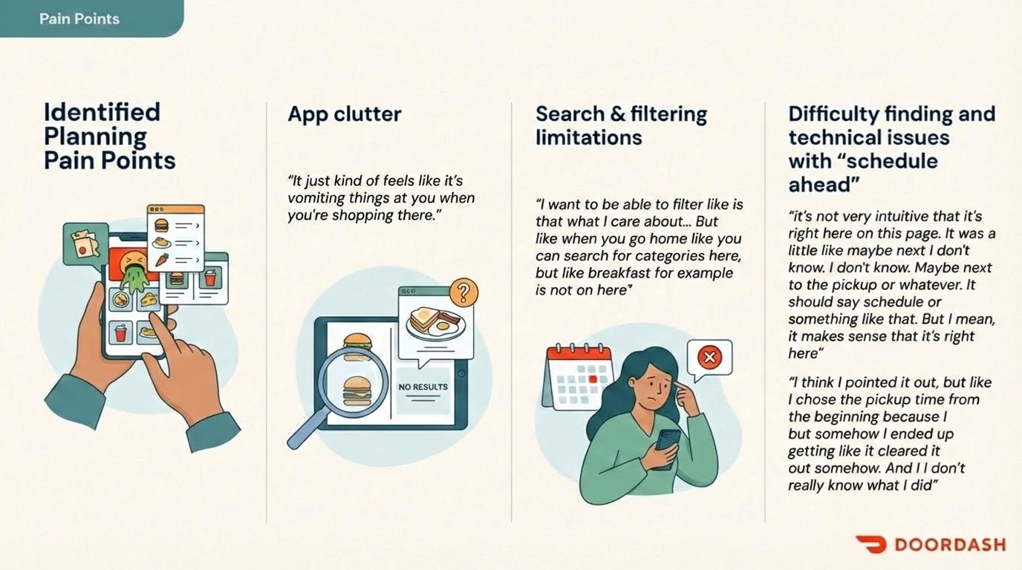

Slide 18
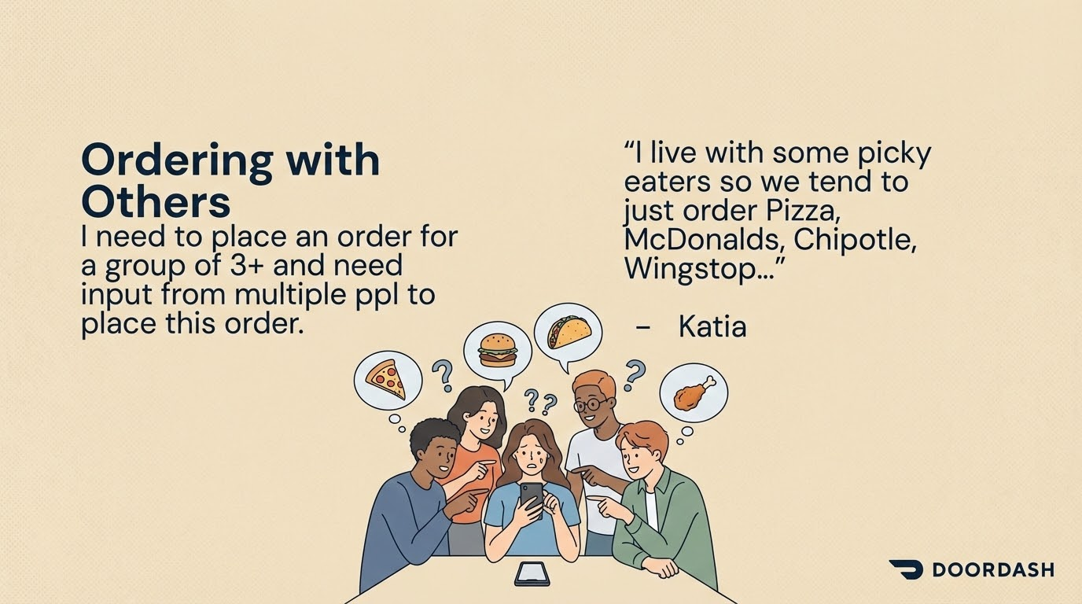

Slide 19
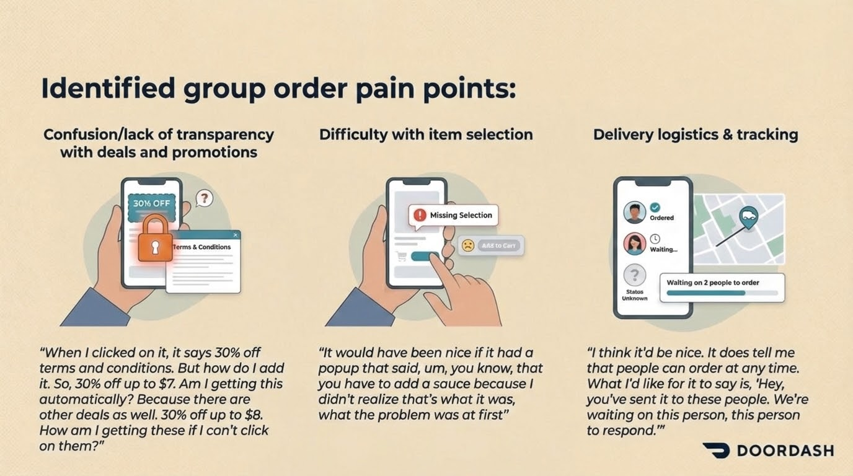

Slide 20
Communication Method | Use Case
In-Person Inquiry | Used when ordering for family in the same household or people sitting nearby. The organizer simply asks what everyone wants.
Direct Screen Sharing | The organizer may "show them the menu on my phone" or ask the group members to take the phone and "look through the menu while it's on Door Dash and just pick what they like and add it to the cart".
External Menu Review | If the group is not physically looking at the DoorDash app, the organizer may have them "jump on a search engine like Google" to look at the restaurant's menu and relay their choices verbally.
Calling/Texting | If the group member is not physically present (e.g., a visitor is on the way), the organizer will call them to give a general rundown of the menu and take their order. If the person is not in the house, the organizer might send a text.
DoorDash Group Order Feature | One user noted the option to "start a group order" and send it out to others. This feature is appealing because it allows the organizer to set a per person spending limit, which is considered "super helpful". However, this was noted as an option, not necessarily the typical process for in-house family orders.
How Cx collect input from others when ordering together

Slide 21
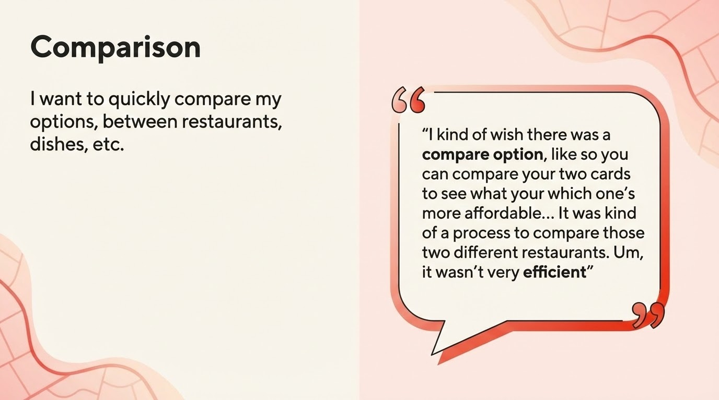

Slide 22
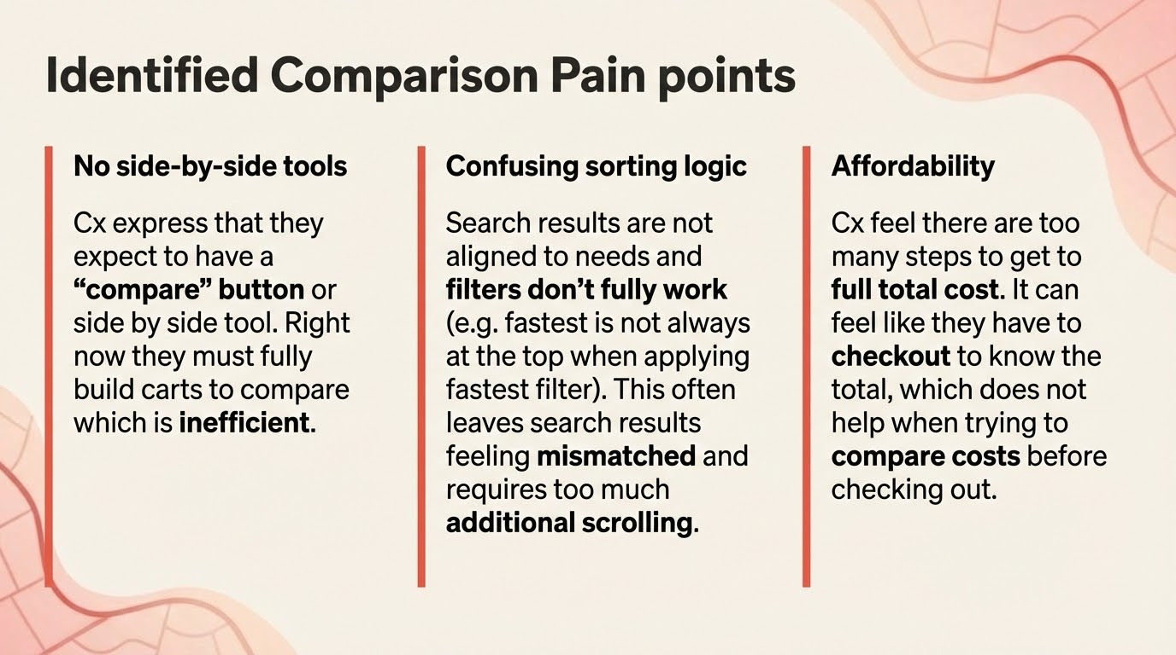

Slide 23


Slide 24
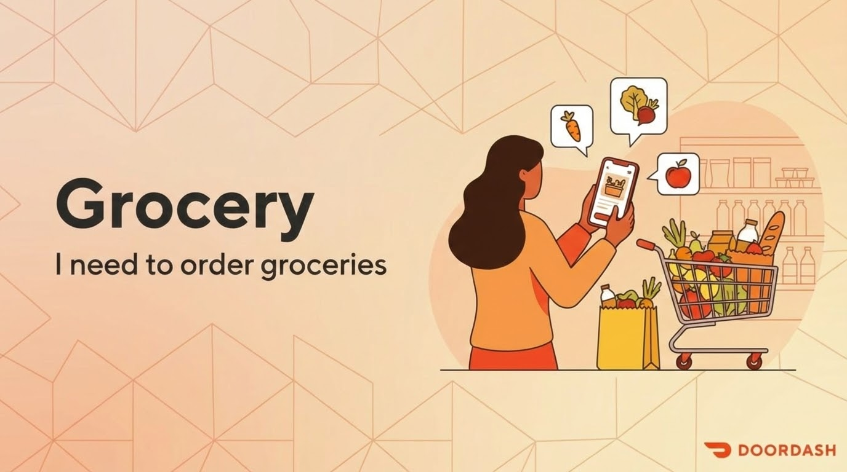

Slide 25
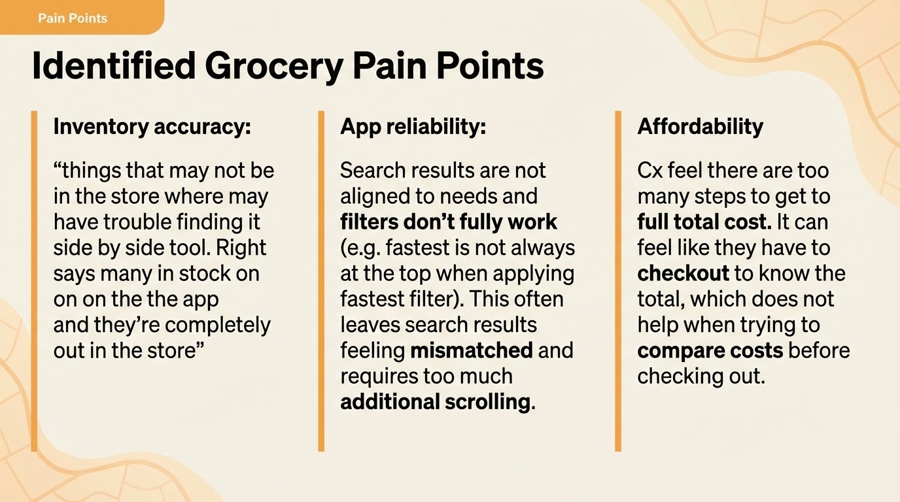

Slide 26
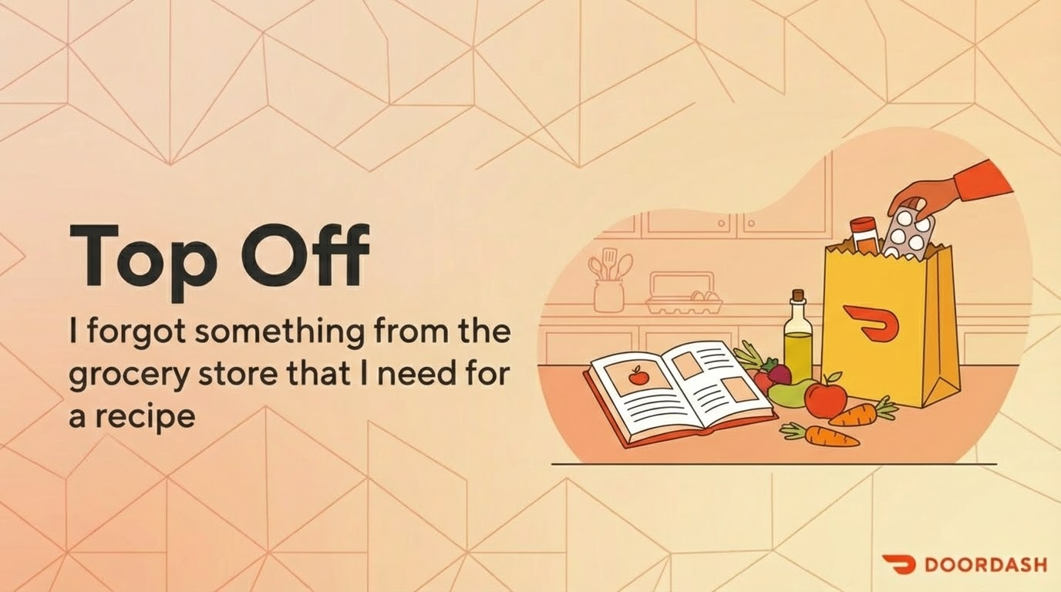

Slide 27
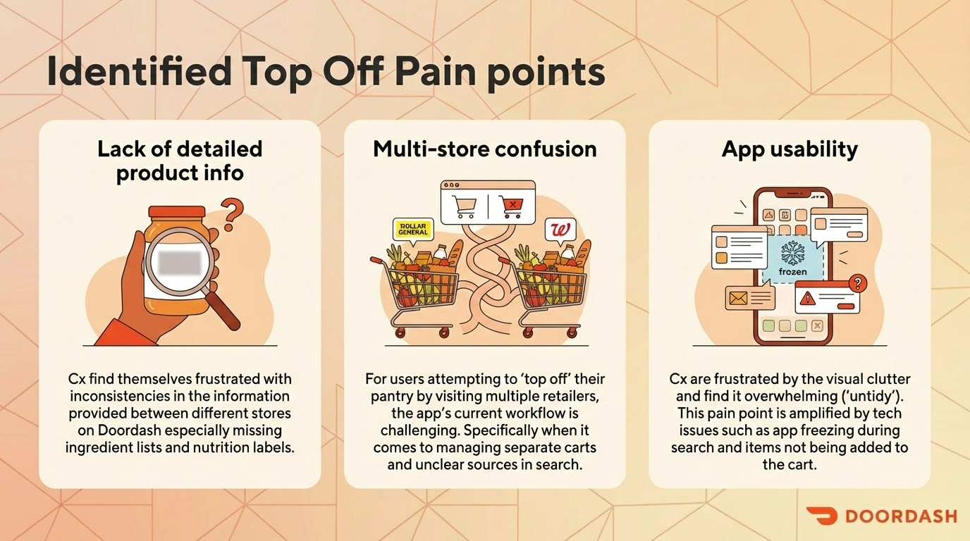

Slide 28
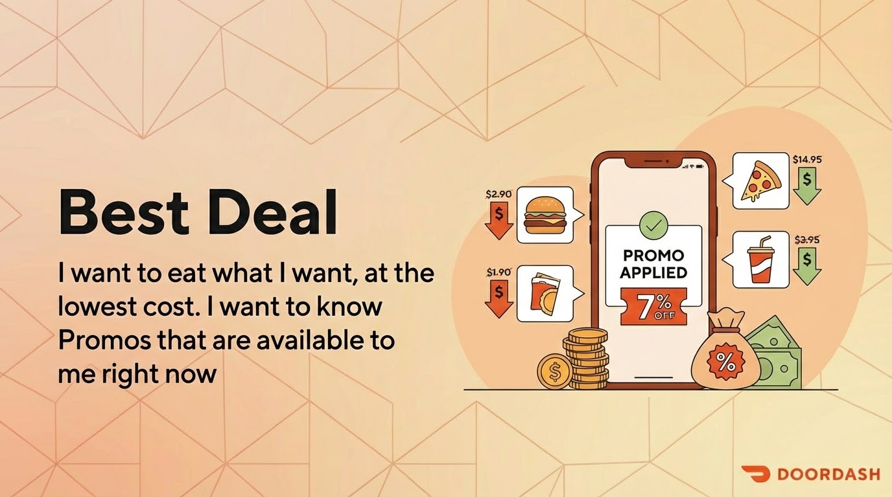

Slide 29
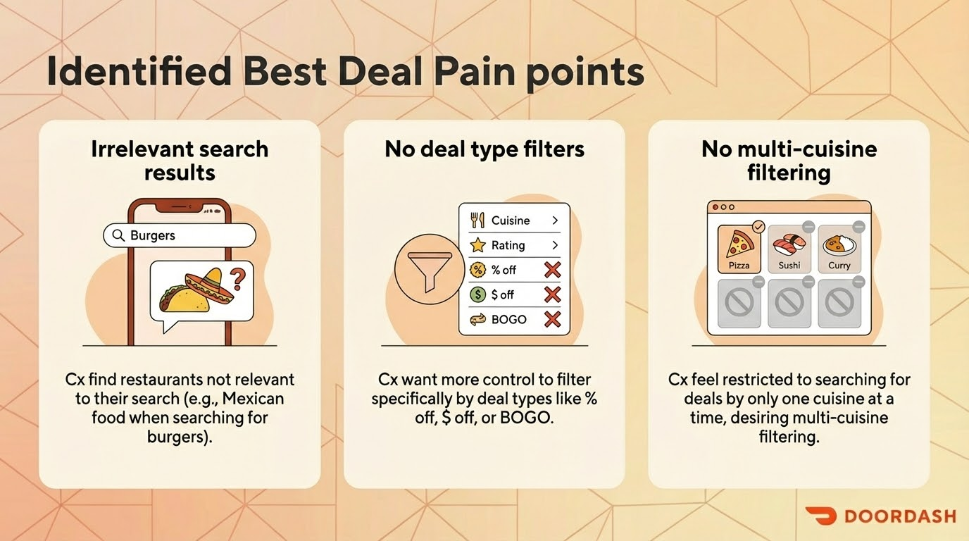

Slide 30
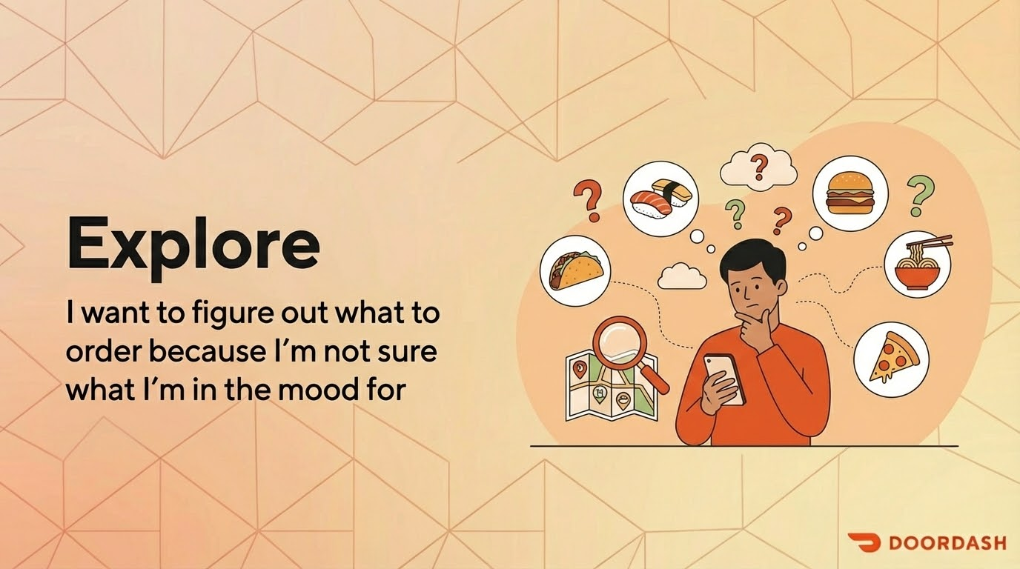

Slide 31
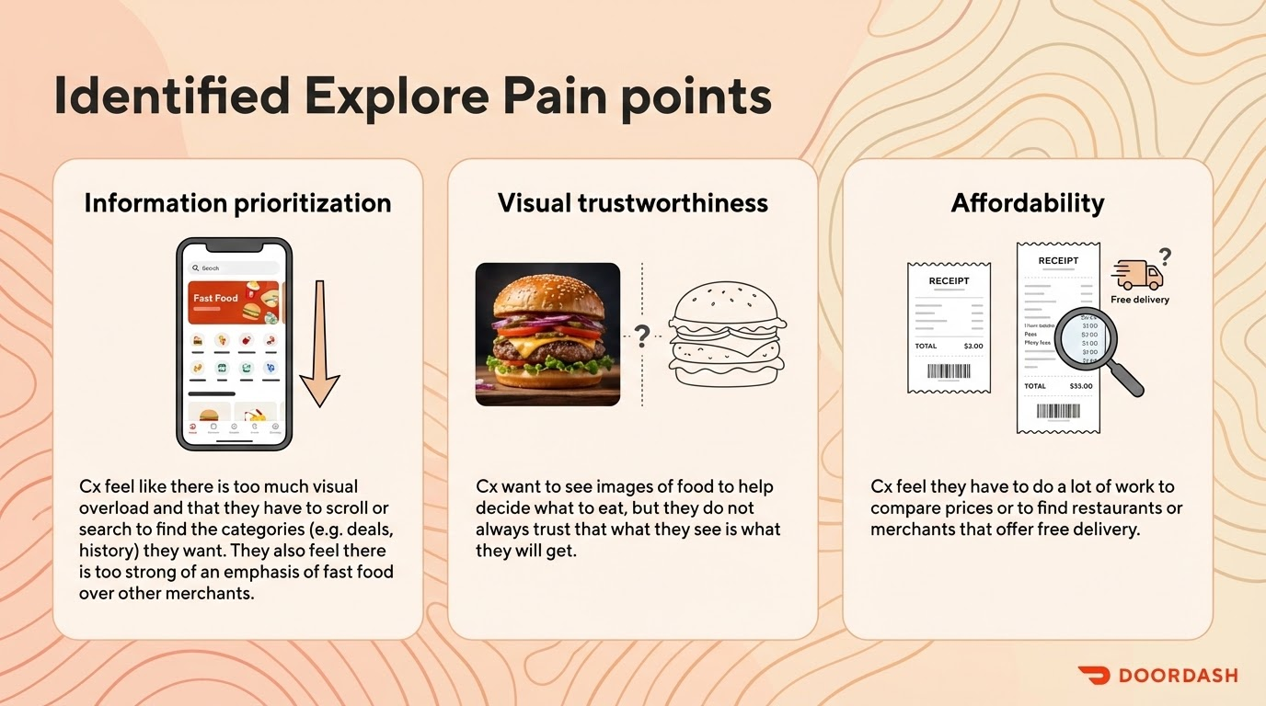

Slide 32
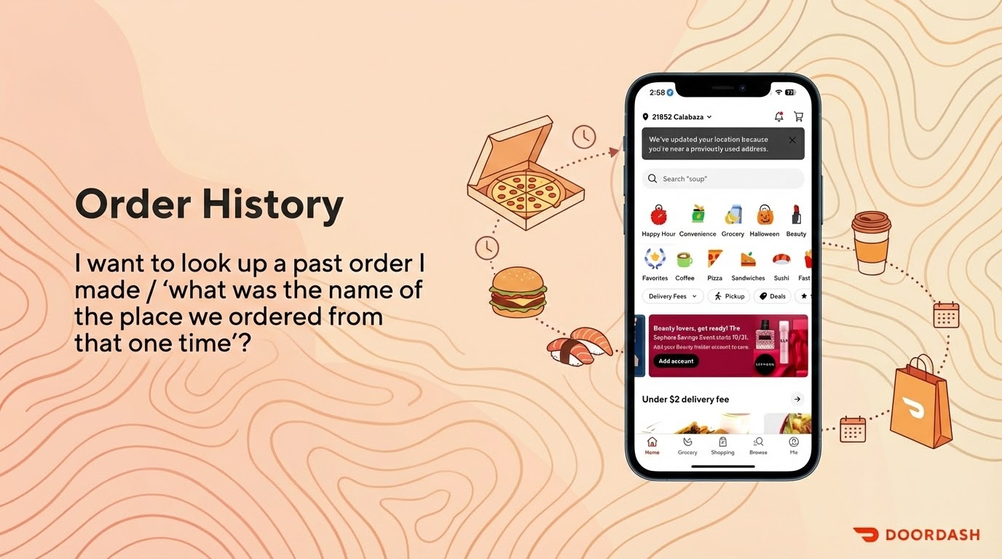
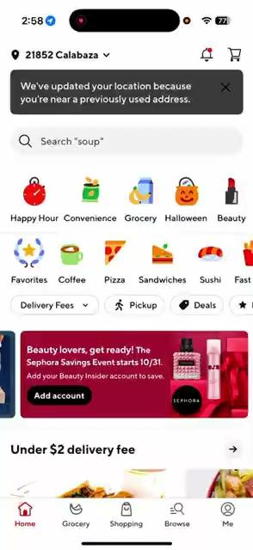

Slide 33
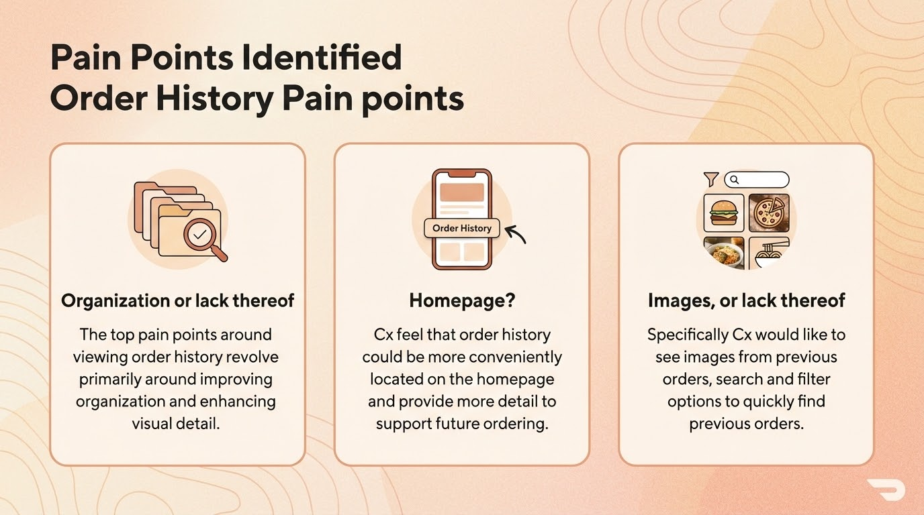

Slide 34
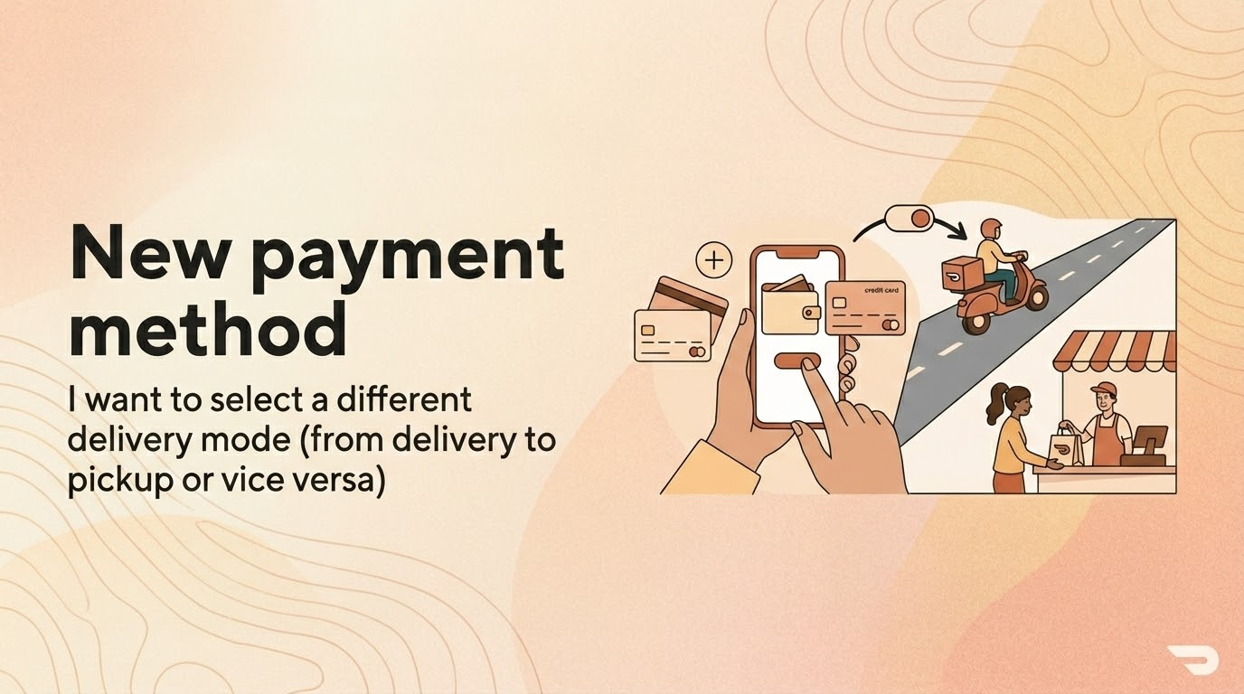

Slide 35
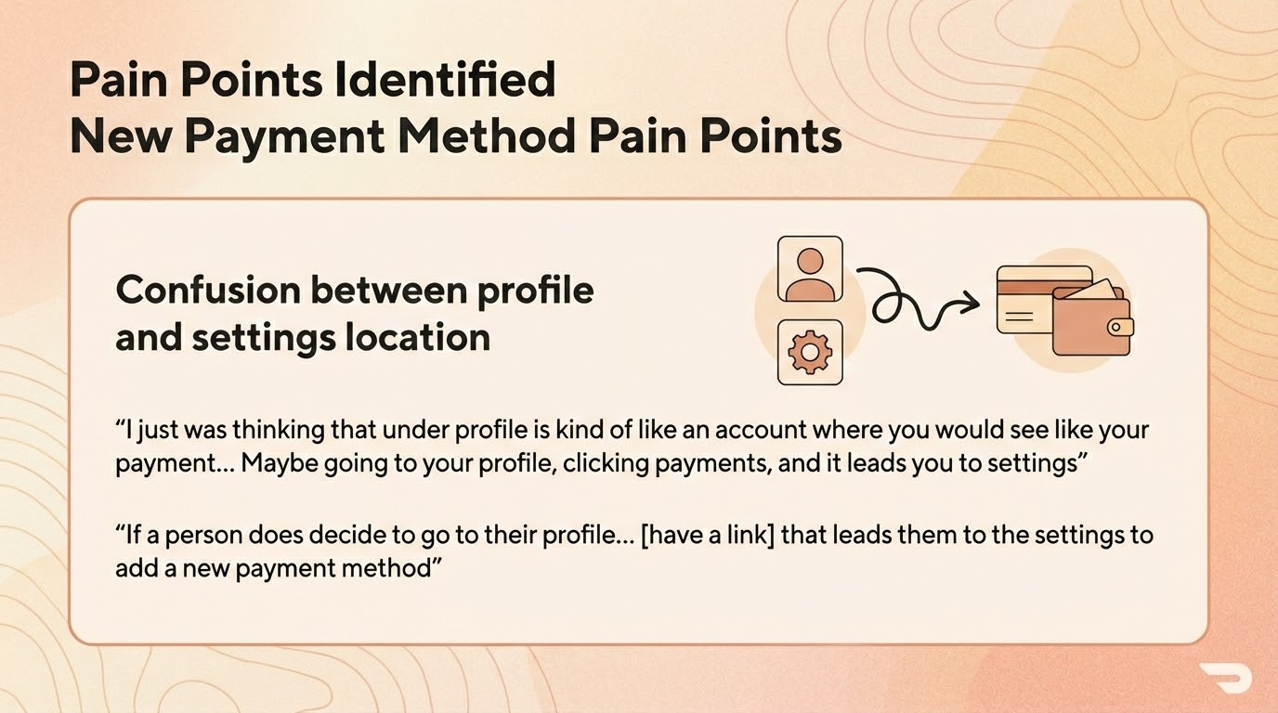

Slide 36
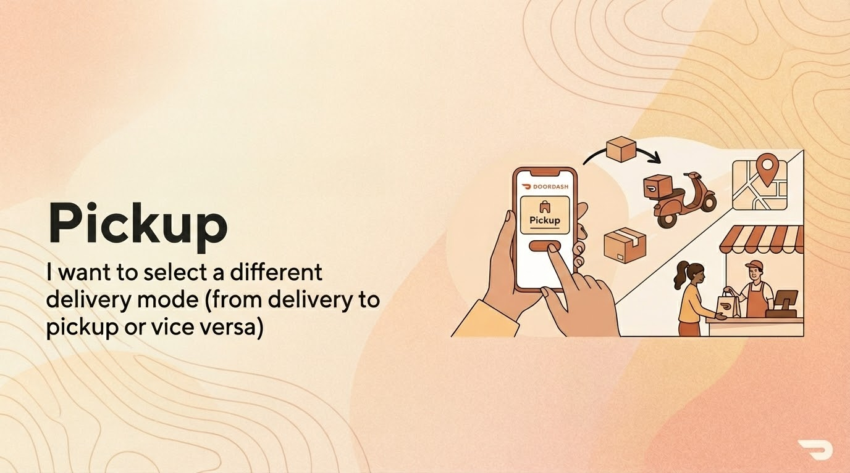

Slide 38
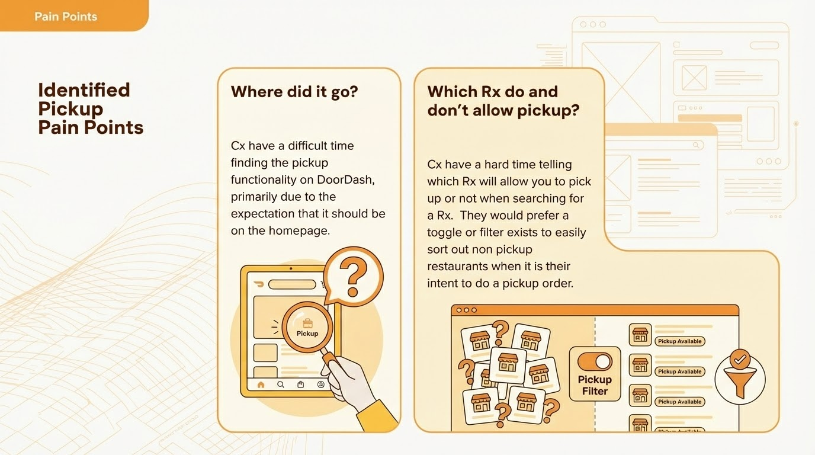

Slide 39


